Slide 1


15 Essential Excel Formulas
Master these powerful Excel formulas to transform your data analysis skills. These formulas will help you work smarter, not harder.
Save time on repetitive tasks. Gain valuable insights from your data. Impress your colleagues with your Excel prowess.
by Parijat Chakraborty

Slide 2
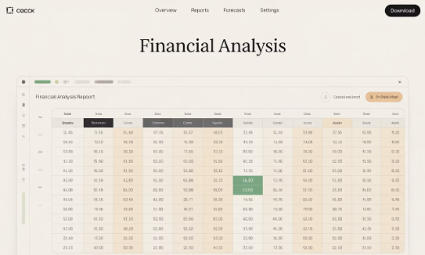
1. SUM
What It Does
Syntax
Adds all numbers in a selected range of cells. It's the foundation of financial calculations and reports.
=SUM(number1, [number2], ...)
Can include individual values, cell references, or ranges.
Perfect for totaling expenses, sales figures, or any numerical data.
Calculate Q1 total sales with =SUM(B2:B10) to quickly find department performance.

Slide 3
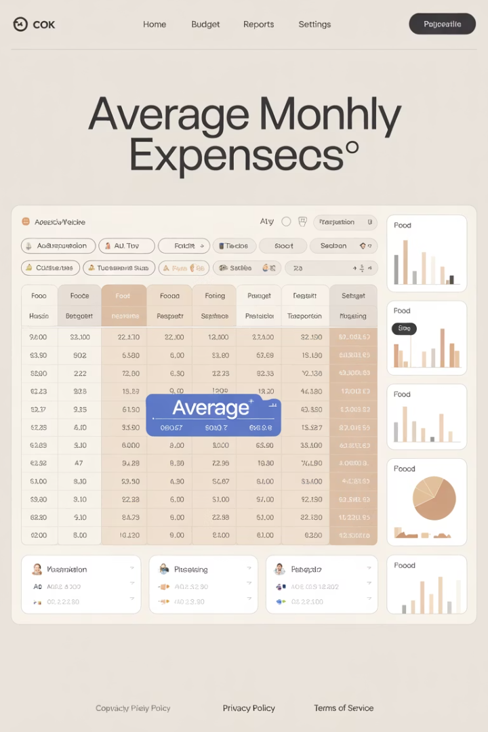



2. AVERAGE
Purpose
Business Usage
Calculates the arithmetic mean of a range. Essential for finding central tendencies in your data.
Track average monthly expenses, customer ratings, or team performance metrics.
Example
Find average monthly expenses with =AVERAGE(C2:C13) to plan budgets effectively.

Slide 4
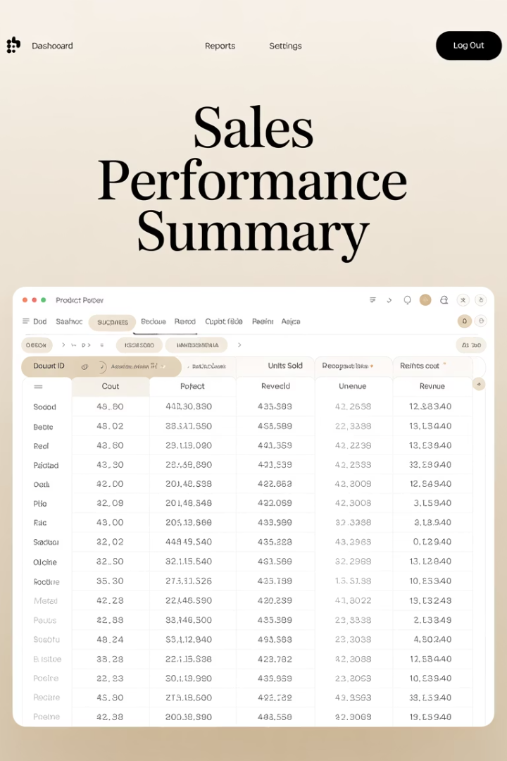
3. COUNT
Function Overview
Business Application
Counts cells containing numbers within a selected range. Ignores text and empty cells.
Determine how many sales transactions occurred. Count completed items in a tracking sheet.
Practical Example
Count number of orders received with =COUNT(D2:D40) to analyze sales volume trends.

Slide 5
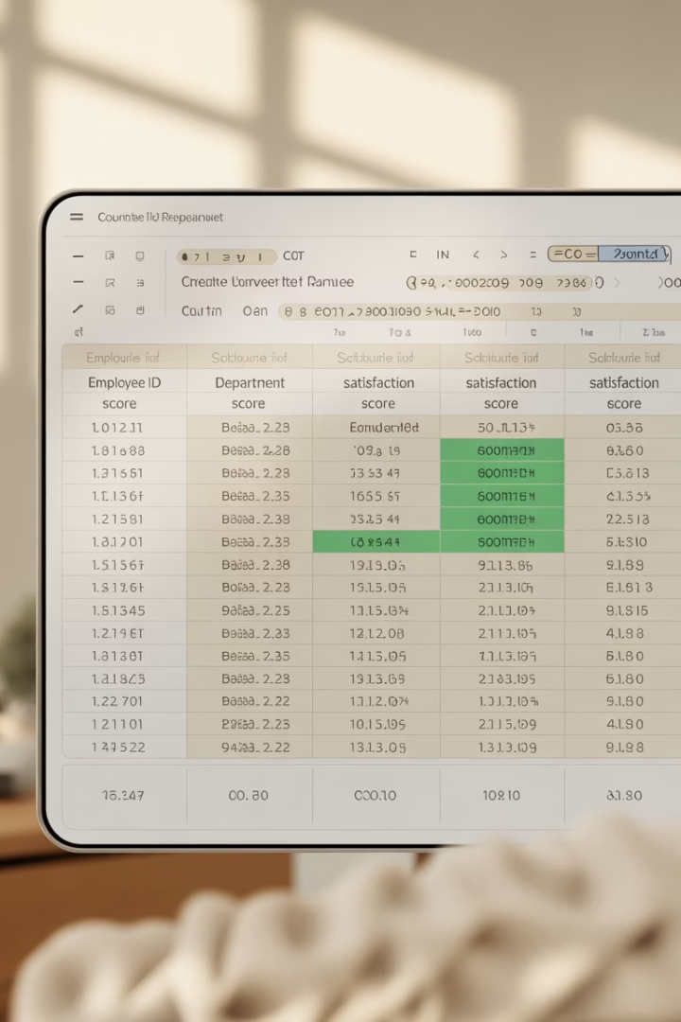
4. COUNTA
1
Identify Formula Need
Need to count all non-empty cells regardless of content type.
2
Apply COUNTA
=COUNTA(E2:E100) counts all filled cells, including text and numbers.
3
Analyze Results
Quickly determine survey completion rates or form submission counts.

Slide 6




5. IF
Logical Test
Evaluate if a condition is TRUE or FALSE. Use comparison operators like <, >, =.
True Result
The value returned when the condition is met.
False Result
The value returned when the condition is not met.

Slide 7






6. VLOOKUP & HLOOKUP
Master Data Analysis
Link data across multiple sheets with ease
Reference Table Data
Pull information from standardized tables
Search Lookup Value
Find specific information in large datasets
VLOOKUP searches for a value in the leftmost column of a table and returns a corresponding value from a specified column.
HLOOKUP searches for a value in the leftmost row of a table and returns a corresponding value from a specified row.
Example: =VLOOKUP(Search Value Cell, Table , Column of Result, FALSE)
HLOOKUP(Search Value Cell, Table , Row of Result, FALSE)

Slide 8




7. VLOOKUP & HLOOKUP
Define Search Value
1
Specify Table Range
Identify what you're looking for in the top row
2
Select the entire horizontal data table
Set Exact Match
4
Select Column/Row Index
Use FALSE for exact matches, TRUE for approximate
3
Choose which row contains your desired data

Slide 9



8. INDEX
(Value from Index No)
Return Specific Cell Values
Precisely locate information in a table
Define Data Range
Select the array containing your data
Specify Row and Column
Indicate exact positions to retrieve data
=INDEX(Array/Table, Row_Num, [Column_Num])

Slide 10
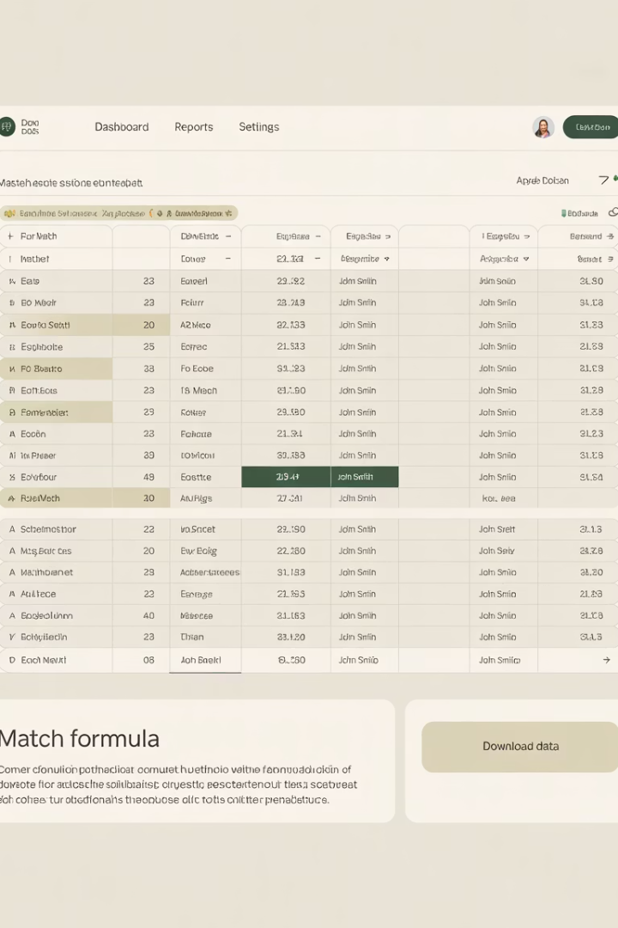



9. MATCH
(Index No from Value)
Locate Positions
Flexible Matching
Powerful Paired with INDEX
Returns the relative position of an item in a range that matches a specified value.
Can find exact matches or nearest values above/below your search term.
Combines with INDEX to create dynamic, flexible lookups across data sets.
=MATCH(Value, Array/Table)

Slide 11
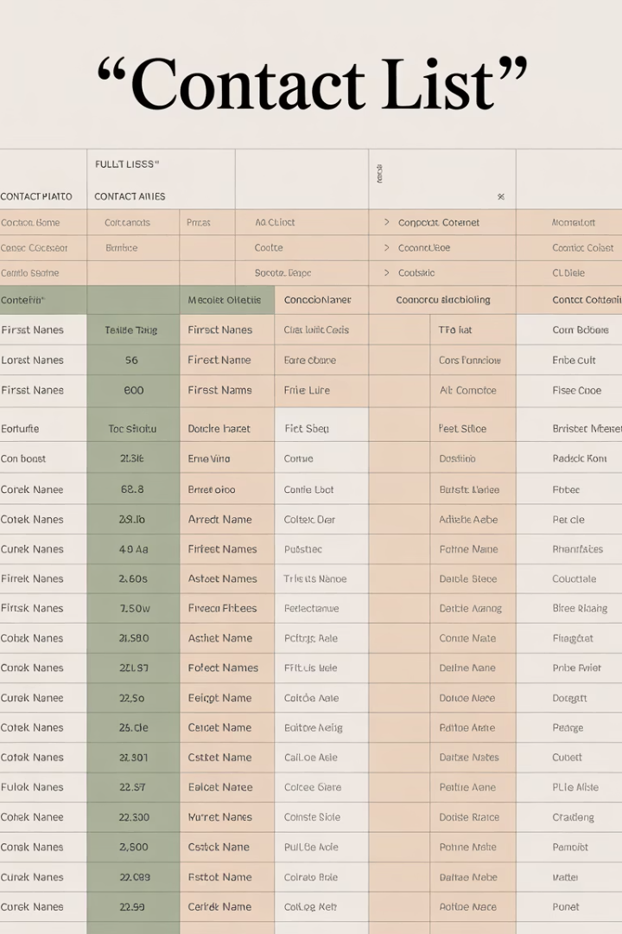
10. CONCATENATE (or CONCAT)
Function
Example
Result
CONCATENATE(A2," ",B2)
First: "John" Last: "Smith"
"John Smith"
CONCAT(C2,"-",D2)
Dept: "Sales" ID: "1234"
"Sales-1234"
CONCATENATE(E2,F2,G2)
Area: "415" Mid: "555" End: "1234"
"4155551234"

Slide 12
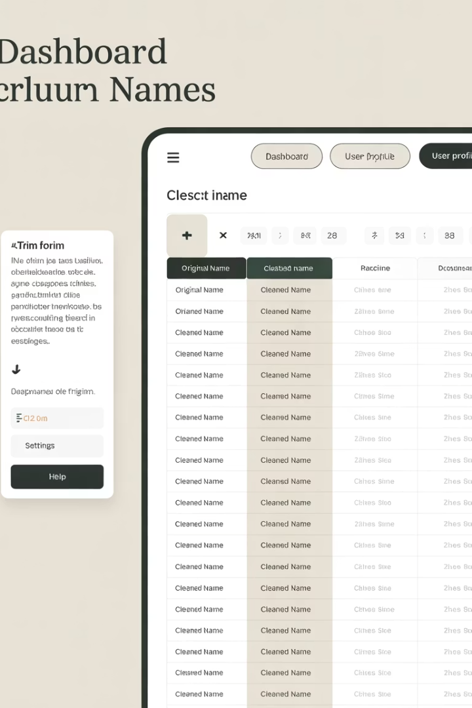
11. TRIM
Identify Data Quality Issues
Spot inconsistent spacing in imported text from external systems.
Apply TRIM Formula
Use =TRIM(C2) to remove all excess spaces except single spaces between words.
Enjoy Cleaner Data
Experience improved sorting, searching, and comparing capabilities with consistent text.

Slide 13






12. LEFT, RIGHT, MID
RIGHT
Extracts characters from end of text.
Example: =RIGHT(E2,4) for last four digits of ID.
LEFT
Extracts characters from start of text.
Example: =LEFT(D2,3) for area code from phone number.
MID
Extracts characters from middle of text.
Example: =MID(F2,4,3) for middle three characters.

Slide 14
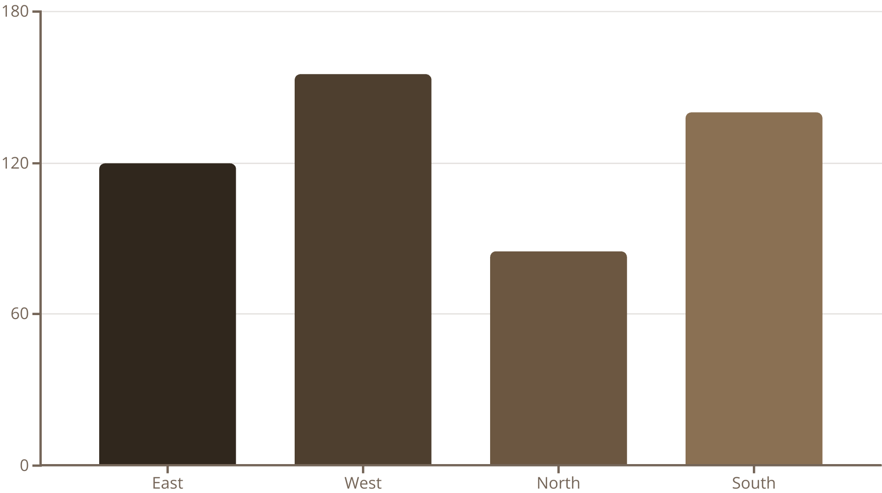
13. SUMIF
SUMIF adds values that meet specific criteria. Syntax:
=SUMIF(range of Criteria, criteria, sum_range).
Example: =SUMIF(A2:A100,"East",B2:B100) totals sales only from the East region.

Slide 15
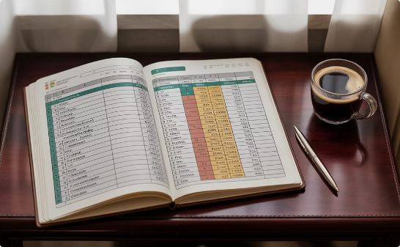
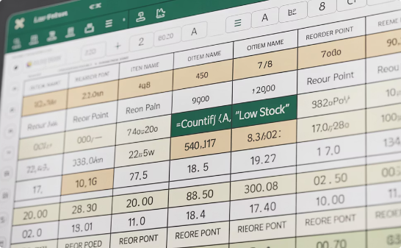
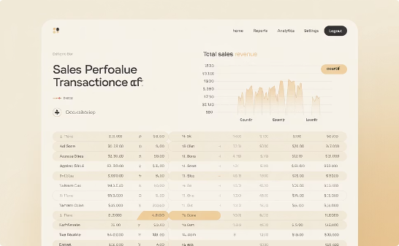
14. COUNTIF
Status Tracking
Inventory Analysis
Sales Performance
Count completed tasks with =COUNTIF(C2:C100,"Completed") to monitor project progress.
Identify low-stock items with =COUNTIF(D2:D50,"<10") to prevent stockouts.
Evaluate high-value deals with =COUNTIF(E2:E100,">10000") to focus on key accounts.

Slide 16
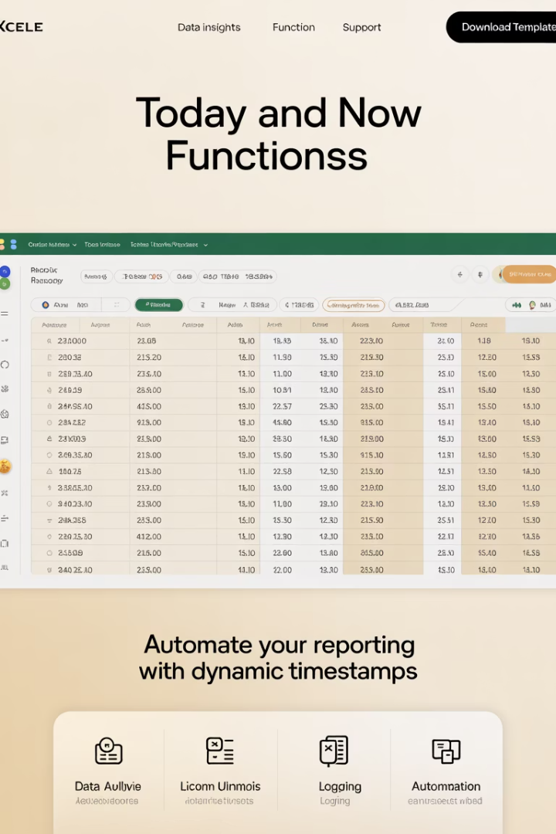
15. TODAY & NOW
0
100%
Arguments Needed
Accuracy Rate
Both functions require no inputs
Pulls current system date and time
24/7
Availability
Functions update automatically on workbook open
=TODAY() shows the current date, perfect for tracking report generation days.
=NOW() displays current date and time, ideal for detailed timestamp logs.

Slide 17
16. PivotTables: Data Analysis Powerhouse
PivotTables transform raw data into meaningful insights without complex formulas. They're Excel's most powerful analysis tool for middle-level employees.
Instant Summaries
Interactive Analysis
Create totals, averages, and counts across multiple dimensions with just a few clicks.
Drag fields to instantly reorganize data views without changing your source data.
Visual Reporting
Dynamic Filtering
Transform complex data sets into clear visual reports that highlight key patterns.
Slice data with filters to focus on specific time periods, regions, or categories.

